Slide 1
The New World of “Political Law”
for Government Contractors
Presentation to Government Contracts
And Public Policy Group
October 5, 2009
Sonia Fois, Esq.

Slide 2
Topics for Today
Political Law Trends In General
Impact on Government Contractors
Lobbying Regulation and Disclosure
– Issue Spotting and “Vendor-as-Lobbyist”
Political Contributions and Fundraising
– Issue Spotting and “Pay-to-Play” Laws
Government Ethics: Gifts and
Entertainment of Public Officials
– Issue Spotting
Top Ten Questions to Assess
Your Political Law Compliance
Scorecard
Recommendations
Questions and Answers

Slide 3
Political Law Trends
State and Local Level
Most State Laws Much Less Developed Than Comparable Federal Laws.
State Laws Vary Dramatically – Thus, No “Common Denominator” Approach.
Local Laws in this Area Emerging.
Like Federal Laws in This Area, Laws Often Applied in Political Context or Used by Competitors as Tool.
Laws Usually Prompted by Recent Scandal in the State.
Broadening Definition of Lobbying.
Stricter Limits on Gifts, Including Gift Bans in Many Jurisdictions.
“Pay-to-Play” Laws.
Heightened Enforcement.
Contingency Fee Restrictions in Majority of States.

Slide 4
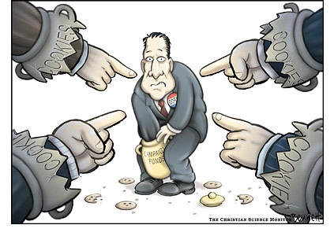
Political Law Trends
Federal Level (New Law)
First Time Lobbyist Liability for Congressional Gift Rule Violations.
No More Free Lunch and Restricted Lobbyist Travel.
More In-Depth Disclosure of Lobbying Expenses.
Sarbanes-Oxley Type Certifications.
GAO Audit Power, But No Independent Oversight Body.
FEC Enforcement of Corporate Anti-Facilitation Rules.
Obama Executive Order on Gifts from Lobbyists.

Slide 5
Political Law Trends
Impact on Government Contractors
Limit or Ban on Political Contributions (“Pay-to-Play” Laws).
Limit or Ban on Gifts to and Entertainment of Procurement Officials.
Registration and Reporting Requirements of “Lobbyists” Applied to Those Involved in the Procurement Process – “Vendor Lobbyists”.
Required Disclosure of Contributions, Communications and Gifts.
Restrictions and Disclosure Rules Flow Down to Company Officials and in Some Cases Their Families.

Slide 6
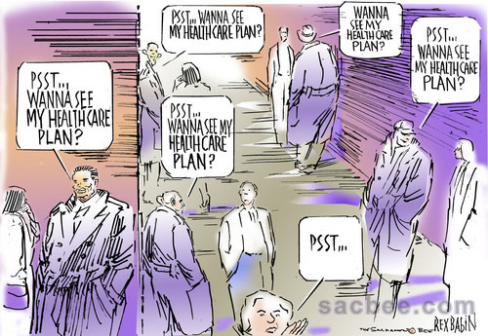
LOBBYING:
ISSUE SPOTTING

Slide 7
LOBBYING
Issue Spotting
What Activities Are Covered as “Lobbying”?
Who Is Covered by the Lobbying Law?
Who Are “Covered Officials”?
Who Has Registration Obligations?
Who Must Report and What Must Be Disclosed?
What Other Restrictions Apply?

Slide 8
LOBBYING
What is Covered?
What Is “Lobbying”?
  General definition – attempt to influence policymaking, and increasingly administrative/executive decision-making.
  Are direct contacts with officials required or just any type of attempt to influence official action (including behind the scenes activities)?
  Is grassroots activity covered (soliciting others to communicate with policymakers)?
  Is “goodwill activity” covered?
  Is procurement activity covered? (Increasingly, yes)

Slide 9
LOBBYING Laws
“Vendor-As-Lobbyist” Laws
Increasingly, lobbying laws expanded to include attempts to obtain a government contract. For example,
    New York, New Jersey, Ohio, Delaware, Illinois, Indiana, Maryland, Massachusetts, Pennsylvania, Texas
Procurement activity expressly included in definition of lobbying or law broad enough to cover it (includes any attempt to influence “administrative action”).
Such activity may meet definition of “lobbying,” but in most jurisdictions must meet other thresholds (discussed below).
Or procurement activity may fall within an exception (discussed below).

Slide 10
LOBBYING
General Exceptions
What Relevant Exceptions Apply?
  Is there any exception for testimony or other information requested by a legislative committee or a state agency?
  Is rendering technical or professional advice to a client considered lobbying?
  Are adjudicatory proceedings or anything that goes on the public record exempted?

Slide 11
LOBBYING
Common Procurement-Related Exceptions
  Submitting a bid solicitation or responding to an RFP.
  Participating in agency-held bid conference after bid specifications are announced.
  Acting as a bona fide sales person.
  Negotiating the terms of a contract.
  Providing advice or performing services pursuant to an existing contract.
  Providing responses to agency requests for information in the context of the procurement process.

Slide 12
LOBBYING
Who is Covered By the Law?
Lobbyists and their employers/clients.
Who is a lobbyist?
  Once your activities meet the definition of “lobbying”, are there other thresholds, like compensation or expenditure thresholds?
  Are there exceptions for in-house people whose principal activity is not lobbying?

Slide 13
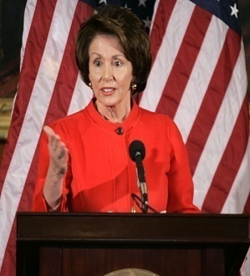
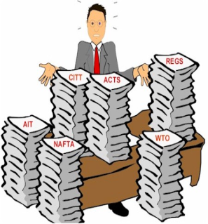
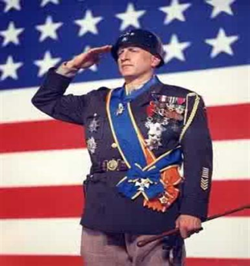
LOBBYING
Who Are “Covered Officials”?
Are contacts with both legislative and executive
branches covered? (Only in less than ten
states is the answer no.)
Which officials are covered?
  State legislators and their staffs are almost always
  covered.
  High-level officials in the executive branch are almost
  always covered, such as the Governor, his chief of
  staff, the Lieutenant Governor, Cabinet Secretaries.
  Employees of state and local governments are
  usually covered.
  Heads and employees of boards, bureaus,
  commissions, councils and public benefit
  corporations or authorities are usually covered.
Does state lobbying law cover local lobbying
or do some localities have their own
rules?
  Increasingly, many localities have their own rules
  (state and local can apply at the same time, e.g., NYS/NYC).

Slide 14
LOBBYING
Who Has Registration Obligations?
Who has to register – the lobbyist, the employer/client, or both?
  The lobbyist almost always has to register.
  Often so does the employer/client.
Does the client/employer have other obligations – such as authorizing the lobbyists’ registrations/reports? (We recommend inserting paragraph in lobbyist contracts.)

Slide 15

LOBBYING
What Reporting Requirements Apply?
Who must file report – lobbyists, employers/clients, or both?
  Typically, lobbyists file more frequent reports than clients or employers.
Does the client/employer have other obligations – such as authorizing the lobbyists’ registrations/reports?
How often must reports be filed?
  Varies from once a year to monthly.
What are the contents of reports?
  Varies from aggregate expenses and no specific contacts named to precise itemization of expenses and disclosure of officials’ names.
  Gifts to officials are typically disclosed.

Slide 16
LOBBYING
What Other Restrictions Apply?
Are there special restrictions on what registered lobbyists may do?
  Restrictions on amount of political contributions or timing of contributions
  Restrictions on gifts, travel with public officials
Are there special requirements on companies doing business with the state and/or contracting with the state?
Are contingency fees permitted?
  Increasingly the answer is “no” in most states.

Slide 17
Obama Lobbying Restrictions
Ban on oral communication by lobbyists re stimulus funds now applies only to competitively bid applications on the stimulus package.
However, it now applies equally to lobbyists as well as non-lobbyists.
From the time of filing of a competitively bid application until grant is awarded, only written communications allowed for both lobbyists and non-lobbyists can have is through writing.
It also appears that all other communications by lobbyists before a bid is filed must be disclosed on the Internet.

Slide 18
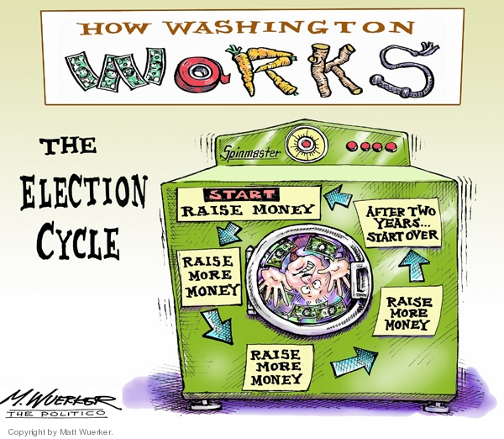
POLITICAL CONTRIBUTION:
ISSUE SPOTTING

Slide 19
POLITICAL CONTRIBUTIONS
Issue Spotting
Who Are Permissible Contributors?
What Are Contributions?
What Exemptions Apply?
What Special Restrictions, If Any, Apply?
What Dollar Limitations Apply?
What Reporting Requirements Apply?

Slide 20
A Political Contribution is:
“Anything of Value” given to a candidate, political committee or party for use in a political campaign.
“Value” generally is fair market value, regardless of cost to donor.

Slide 21
POLITICAL CONTRIBUTIONS
Types of Contributors
Corporations? (majority of states, yes)
Government Contractors (pay-to-play rules)
Corporations that are government contractors?
PACs?
Individual executives/employees?
Others?

Slide 22
POLITICAL CONTRIBUTIONS
Types of Contributions
Money (cash, checks or credit cards)
  Are there limits on cash contributions?
  Are there rules on credit card contributions?
Possible in-kind contributions (unless an exception applies), include for example:
  Free or discounted use of corporate goods, facilities or services of corporate personnel.
  Meals, travel, lodging for candidate and his/or her volunteers and agents.
  Loans, credit, settlement of debt.
  Free or discounted legal and accounting services.
  Pay for advertisements.
  Pay for/provide campaigns materials.
  Conduct voter drives, GOTV.
  Candidate “meet and greets”.
  Provide employee mailing lists.
  Communicate electoral views to shareholders and/or employees.
  Conduct/pay for polls or surveys.

Slide 23
POLITICAL CONTRIBUTIONS
Typical Types of Exemptions
Support for the company PAC.
“Volunteer” work (including limited use of corporate facilities).
Communications with company’s own “restricted class.”
Nonpartisan voter drives.
Legal and accounting services for compliance purposes.

Slide 24
POLITICAL CONTRIBUTIONS
Special Restrictions
Are there special limits or restrictions that apply to government contractors, or firms that do business in the state or that are regulated by the state or local government? (see below)
Are there special limits or restrictions that apply to lobbyists or lobbyist employers?
Are there blackout periods (e.g., prohibition on contributions while the legislature is in session or within a prescribed period prior to an election) or other timing considerations for contributions?

Slide 25
POLITICAL CONTRIBUTIONS
Special Restrictions
Are there rules regarding how you may
solicit contributions from colleagues and
subordinates in connection with your
volunteer activities?
  Federal law fleshes this out, but state laws
  remain gray.
Are there restrictions on giving in the
name of another? Reimbursement of
contributions?
  Typically a violation everywhere.

Slide 26
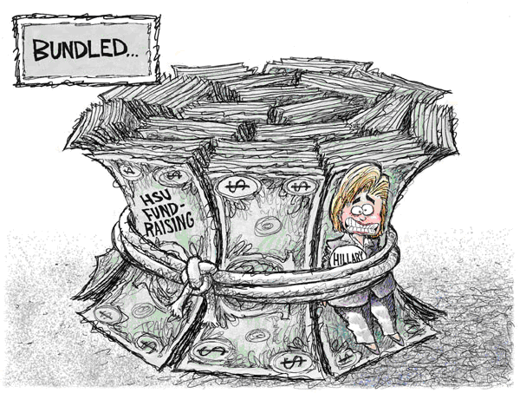
POLITICAL CONTRIBUTIONS
Special Restrictions
Are these restrictions on “bundling” of contributions (collecting the contributions of others and sending them on to the candidate)?

Slide 27
POLITICAL CONTRIBUTIONS
Pay to Play Laws
About 13 states restrict bidding and/or contracting entities in the making of political contributions (and also set forth disclosure obligations). (CA, CT, CO, GA, HI, IL, KY, NJ, NM, OH, SC, VT, WV).
About 3 states while not restricting contributions still require reporting of contributions by bidding and/or contracting entities. (MD, PA, RI)

Slide 28
POLITICAL CONTRIBUTIONS
Pay to Play Laws
State laws vary widely and differ according to:
    Kinds of contracts covered
    Whether contract is sole source or competitive bid basis
    Whether restrictions are in the form of a ban or limitations on contributions
    Which parties are covered: the contracting entity alone; the entity and certain company officials; or all of the above plus spouses and dependents?
    Which candidates, political parties or political action committees are covered?
    Trigger for the restrictions
    Look-back and look-forward provisions, which capture contributions by companies or restricted persons for some period of time before and after a contracting decision.

Slide 29
POLITICAL CONTRIBUTIONS
Pay to Play Laws
  Whether there is an opportunity to cure an improper contribution
  Certification and notification requirements
  Penalties for violations and enforcement stance
  Available interpretative guidance – most jurisdictions have little to no definitional guidance; particularly true regarding the scope of covered company officials and family members.
Increasing number of local pay-to-play laws (New York City, Los Angeles, Cook County, Philadelphia).
Also agencies and authorities (LAMTA) may have their own pay-to-play restrictions.

Slide 30

GIFTS/ENTERTAINMENT:
ISSUE SPOTTING

Slide 31
GIFTS/ENTERTAINMENT
Issue Spotting
Who Does the Rule Cover?
  What type of officials?
  What type of donors?
What Does the Rule Cover?
What Reporting Requirements Apply?

Slide 32
GIFTS/ENTERTAINMENT
Who Does the Rule Cover?
Officials:
Do state gift laws apply to local and county officials, and/or do at least some of these localities have their own rules?
Are both branches – executive and legislative – covered and, if so, do they have distinct rules for each branch?
Are the families and spouses of officials covered?
Are there special restrictions on recipients who are procurement officials? (Increasingly, yes)

Slide 33

GIFTS/ENTERTAINMENT
Who Does the Rule Cover?
Donors:
Are all donors subject to the same rules or are only certain donors – such as lobbyists, lobbyist employers, and government contractors – covered or subject to additional restrictions? (Increasingly, yes)
Is there legal liability on the part of the donor if the ethics rules are violated?

Slide 34
GIFTS/ENTERTAINMENT
Impact on Government Contractors
Government contractors are subject to same gift restrictions as everyone else.
Lobbyists and their employers tend to be subject to additional gift restrictions; so government contractors who employ or retain lobbyists also subject to these stricter limits.
A majority of states impose limits, on top of those applicable to the public and to lobbyists/lobbyist employers, on government contractors.
These special restrictions typically are much more narrow than in the political contribution area and apply only to those officials working on a particular procurement and not to any public official in the state.

Slide 35
GIFTS/ENTERTAINMENT
What Does the Rule Cover?
What is a gift? (A meal? A ticket to a sports events? A round of golf? Use of a conference room?)
What is an illegal gratuity?
Are there limits on the value of gifts that may be given either per single gift or event or a yearly aggregate limit?
Are affiliates of an organization and the organization considered one source or separate sources for purposes of any gift-giving limits?
How do you value a gift, such as tickets to sporting events and luxury boxes?

Slide 36

GIFTS/ENTERTAINMENT
What Does the Rule Cover?
What exceptions apply?
  Many states have de minimis exceptions (under a certain dollar amount).
  Many states subject food and beverage to special rules or exemptions, particularly meals taken in a group setting.
  Many states have exceptions for an official’s attendance at, and travel related to, a conference, reception or seminar.

Slide 37
GIFTS/ENTERTAINMENT
What Reporting Requirements Apply?
Does the official have to report the gift?
  On what type of report?
  Are there dollar thresholds or exemptions on reporting?
Does the non-lobbyist donor have to report the gift?
  On what type of report?
Do lobbyist or lobbyist employer donors have to report the gift on their lobbying reports?
  Typically yes.

Slide 38
Obama Executive Order
  Obama Executive Order on gifts supplements and supersedes OGE Rules.
  EO applies to political appointees only.
  Lobbyists and organizations employing lobbyists are covered as well as employees within the organization.
  But organizations retaining outside lobbyists only (they are “clients”, not lobbying registrants) are not subject to EO.
  EO is a gift ban with only a few exceptions (personal friendship, but NOT de minimus gifts or widely attended events).
  Ban applies to appointees in all agencies, even those with which lobbyist has no dealings.

Slide 39

Epilogue
Top Ten Questions to Assess Your Political Law Compliance Scorecard
Compliance System Establishment: Do you have a documented compliance program for the areas of federal and state lobbying, government ethics/gifts to public officials, political contributions, and government procurement activity, which is transparent to all employees and is spearheaded by a high-level executive or executives within the Company (“compliance czar”)?
Lobbying Registration/Reporting: Specifically, are there policies and procedures in place for determining whether your company, in-house employees and retained consultants are required to register and report under federal, state and local lobbying laws?

Slide 40
Epilogue
Top Ten Questions to Assess Your Political Law Compliance Scorecard
Political Contributions: Do you have a similar system for tracking and approving company/PAC/employee political contributions – monetary and in-kind – to federal, state and local candidates, party committees and political action committees (PACs)?
Use of Corporate Resources for Fundraising: Does your compliance program cover political fundraising conducted in the office or during office hours, or otherwise using corporate assets (e.g., personnel/ volunteers, facilities, company jet) and corporate communications with election-related content?
Gifts/Entertainment: Do you have a system for approving and tracking “gifts” to public officials, such as meals, entertainment and travel?
Procurement Restrictions: Are company employees involved in government contracts trained in the special restrictions that apply to government contractors in the areas of lobbying, gifts and political contributions, particularly at the state and local level?

Slide 41
Epilogue
Top Ten Questions to Assess Your Political Law Compliance Scorecard
Conflict-of-Interest Rules: Are employees who are going in and out of the “revolving door” of government in compliance with the myriad conflict-of-interest rules that apply to them?
Consultants: Are your consultants aware of and complying with your Code of Conduct and do your contracts reflect your compliance requirements?
Third Party Groups: Are your charitable contributions/activities and participation in trade associations or other industry/civic groups part of this compliance system?
Compliance Implementation: Do you routinely educate/train employees on these rules (including alerts on new developments), conduct audits, discipline violators and change the program as needed?

Slide 42

SOME FINAL THOUGHTS . . . .
Do not have the “fox guarding the hen house.”
Consider a compliance system broken down regionally by business or practice areas or in any way that gels with your business model.

Slide 43
SOME FINAL THOUGHTS . . . .
Think “outside the box” when considering who may be a “lobbyist” in your business or how your business may be inadvertently making a political contribution.
Do not be intimated by the wealth and breadth of the laws and procedures governing the political area. Train employees to spot the issues and raise questions with the relevant company officials and consult outside counsel as needed.
Establish and document clear and simple policies and procedures and make sure they are routinely disseminated to employees.
Set up a calendar of filing dates and file reports accurately and in a timely fashion.
Maintain accurate records.
Be responsive to enforcement officials and their inquiries.
Do not forget about consultants and other agents.
When in doubt, apply the “How would it look in the Washington Post” standard and of course, always call your compliance folks when in doubt about a contemplated activity.

Slide 44
Questions?

