Slide 1
Alternative Dispute Resolution
IP Dispute Resolution - 29th June 2012

Slide 2
Why think about ADR?
“ADR (particularly mediation) has a vital role to play in reducing the costs of civil disputes, by fomenting the early settlement of cases. ADR is, however, under-used. Its potential benefits are not as widely known as they should be.”
Lord Justice Jackson (Final report page xxii)

Slide 3
Why think about ADR?
“… Starting proceedings should usually be a step of last resort, and proceedings should not normally be started when a settlement is still actively being explored. Although ADR is not compulsory, the parties should consider whether some form of ADR procedure might enable them to settle the matter without starting proceedings. The court may require evidence that the parties considered some form of ADR […and the court may asses the conduct of the parties when determining costs].”
Civil Procedure Rules
Practice Direction - Pre Action Conduct

Slide 4
Why think about ADR?
“…the Patents County Court encourages parties to consider the use of ADR (such as, but not confined to, mediation and conciliation) as an alternative means of resolving disputes or particular issues within disputes.
...Settlement of a dispute by ADR has many advantages. It can result in significant saving of costs. It also has the potential to provide the parties with a wider range of solutions than can be offered by litigation…
Legal representatives should consider and advise their clients as to the possibility of seeking to resolve the dispute via ADR …[early in the case] the Judge will ask whether the parties have been advised about ADR and whether an adjournment is being sought.”
PCC Guide, 12th May 2011

Slide 5
Why might you reject ADR?
Immediate injunctive relief required
Summary judgment likely
Test case: precedent needed
Publicity
Parties have no interest in a deal

Slide 6
Why try ADR?
There are many cases that might be suitable for ADR
Example
A patent licence dispute
Issues will probably include:
Meaning of the agreement
Is it clear enough to determine, in every case, what is and what is not licensed?
Can that uncertainty be clarified by litigation?
Scope of the patents
Validity of the patents
EPO proceedings?
Invalidity proceedings in other countries?
Law and jurisdiction: expense of litigation, uncertainty of outcome
Public
What are the alternatives to litigation?

Slide 7
Methods of Resolving Disputes
What is ADR? – anything other than litigation, e.g.,
Arbitration
Negotiation
Mediation
Executive tribunal (‘mini-trial’)
Early neutral evaluation
Expert determination
Med-Arb

Slide 8
Litigation or Arbitration What are the main differences?
Both are rights based, adjudicative, and binding
Litigation is public, but an arbitration is private
Litigation may be multi-jurisdictional, arbitration is a single forum, with one decision, enforceable globally (usually)
no risk/likelihood of conflicting decisions
Appeals are usual in litigation, but limited in arbitrations
ECJ references can only be made by a court

Slide 9
Mediation or Arbitration What are the main differences?
Mediation is non-binding
it only becomes binding when parties enter into written agreement setting out terms of settlement
By contrast, arbitration is adjudicative, and binding
Mediation takes into account the interests of the parties and is interest based
Arbitration is, by contrast, rights based
Mediation and Arbitration are not mutually exclusive
mediation is a stand-alone procedure, but it can provide a first step to arbitration or court litigation, in the absence of settlement

Slide 10
ADR – main advantages
Voluntary (apart from arbitration), may be cheaper, quicker (a skilled neutral may be able to offer a swift solution, before the dispute escalates)
Flexible (particularly in mediation, parties are able to be more creative with settlements)
Private and offers a practical alternative: may preserve commercial relationships
Non-binding in many cases (advantage and disadvantage)
Objective (apart from negotiation), offers intervention from an independent third party who may be able to offer an objective view on the matter

Slide 11
Myths, prejudices and preconceptions True or False?
ADR is:
quick
not binding
a sign of weakness
not a proper adjudication
not to tried until late in the case
not appropriate for a complex case
just a delay to the inevitable litigation
a waste of time and money if the case does not settle
never appropriate for IP cases: you infringe or you don’t!

Slide 12
ADR Case Study #1 – Aussie Co.
Aussie Co owns a patent for HiFi sound technology. English Ltd makes HiFi equipment.
Aussie Co says English Ltd needs a licence, and sues for patent infringement.
The parties meet several times for cordial, but tense discussions. Aussie Co demands a licence is agreed at a high royalty rate, which would destroy English Ltd’s profit.
The case reaches trial. On the eve of trial, Mr. K, lawyer for English Ltd, calls his opponent and suggests mediation. This is quickly arranged, to begin on the same day that the trial begins: the trial and the mediation proceed at the same time.
The mediation starts. Each side makes an opening statement...

Slide 13
ADR – main disadvantages
Common disadvantages
Private: litigation allows for showcase trial (pour encourager les autres)
One decision: litigation may suit a multi-forum dispute for a deep pocketed patentee
Mediation specific
A party may feel psychologically disadvantaged in having disclosed a position, perhaps, the bottom line for settlement, if the mediation fails
Arbitration specific
Pre-emptive remedies require court intervention

Slide 14
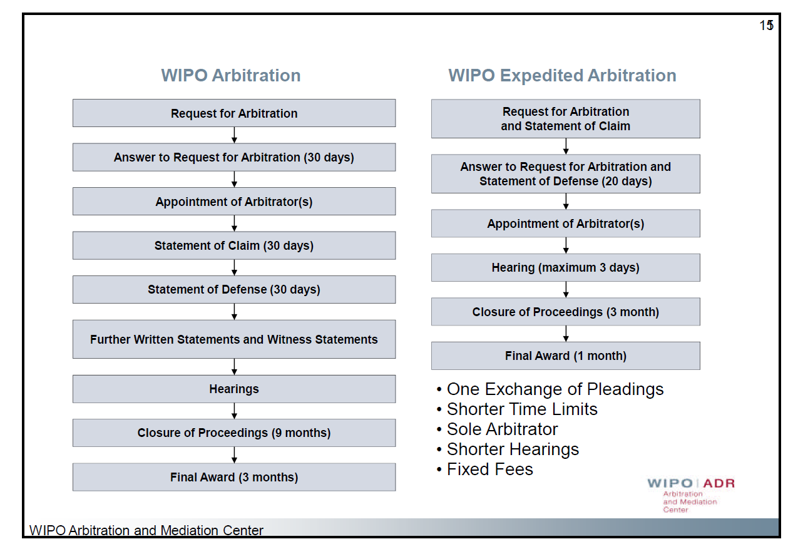
What happens in practice? Arbitration
Effective arbitration clause
Administrator: WIPO, ICC, LCIA etc.
Rules of engagement
Selection of panel of arbitrators
Timetable and directions for hearing
Statements and Evidence
Hearing
Decision

Slide 15
ADR Case Study # 2 – Clever-Milch
Clever-Milch GmbH owns patents for purifying milk. It licences those patents to several cheese making companies, including Squeezy-Cheezy, Inc of Monroe, Wisconsin, who are just about to launch a new product called Angel’s Tears Squeezy Cheese.
Royalty payments depend on use of the patents. A dispute arises as to which patents are being used by Squeezy. The licence agreement has no ADR clause.
Letters are exchanged, and litigation begins in England.
The parties meet to discuss settlement; the meeting is off the record. The parties have very different views of the case.
At the same time, the parties discuss binding arbitration, as an alternative to litigation.
Clever -Milch rejects the arbitration option...

Slide 16
What happens in practice? Mediation
Agreeing to mediate: who makes the first move?
Administrator: CEDR, WIPO, IPO etc.
Rules of engagement
Selection of mediator(s)
Timetable and preparation for the mediation
Pre-meetings with, Statements to, and other information for review by mediator
Mediation: tactics/strategy?
Agreement

Slide 17
Reprise: Case Study # 2 – Clever-Milch
On the way to trial the parties continue to meet and talk. A similar case in the U.S. forces the parties to mediate, and an issue in the mediation is the settlement of the English litigation. The mediation makes some progress, but ultimately fails.
The case proceeds to trial, but the parties keep talking during and after the court hearing. The judge takes time to write his judgment ...the parties talk again.
Once positions and possible solutions are mapped out...and each side understands the other’s position (but without accepting it)...the parties talk about other things that they want.
Squeezy asks that both cow’s milk and goat’s milk be covered by any deal – it agrees to pay more overall if goat’s milk is included.
The case settles hours before the judge hands down his decision.

Slide 18
Litigation/Arbitration v. Mediation ADR Case Study #2
Solutions
Positions
Interests

Slide 19
ADR - Summary
 | Neutral 3rd party | Non-binding | Binding | Private
Arbitration | ✓ |  | ✓ | ✓
Mediation | ✓ | ✓ |  | ✓
Negotiation |  | ✓ |  | ✓
Executive tribunal | ✓ | ✓ |  | ✓
Early neutral evaluation | ✓ | ✓ |  | ✓
Expert determination | ✓ |  | ✓ | ✓
Med-Arb | ✓ |  | ✓ | ✓

Slide 20
Effective Dispute Resolution
To get the most of ADR, treat it seriously and run it on a par with, and perhaps in parallel to, litigation
A well thought through ADR clause, which is consistent with the businesses’ objectives, can assist in dispute resolution:
no party can be forced to resolve a dispute by ADR (save for binding arbitration)
but a clear and practical ADR clause can remove:
brinkmanship
belligerent behaviour
...and accelerate the satisfactory resolution of the dispute
If at first you don’t succeed, try again
many disputes later settle following first consensual meeting

Slide 21
Alternative Dispute Resolution
IP Dispute Resolution - 29th June 2012

